Slide 1
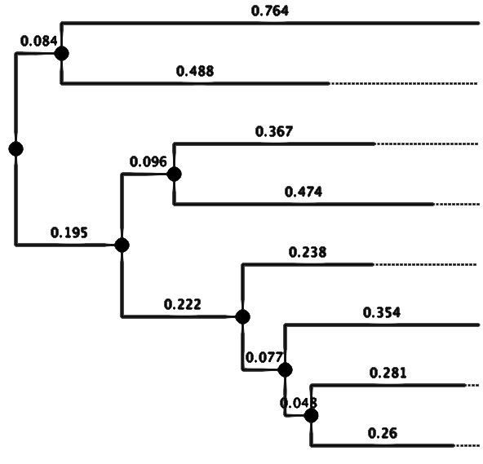

Principles of Molecular Epidemiology
nathan grubaugh, phd

Slide 2
Outline
Fundamentals of pathogen genomic epidemiology
How pathogen genomics aids epidemiology
Phylogenetics to reconstruct transmission
Assess similarity among sequences
Represent and read phylogenetic trees
Phylogenetic methods
Distance methods – pairwise distance and substitution models
Maximum likelihood methods
Bayesian methods – molecular clock
Probability errors and validity
Types of errors
Bootstrapping
Sources of errors
Empirical validation

Slide 3
Pathogen genomic epidemiology: fundamental concepts

Slide 4
Pathogen genomics to answer epidemiological questions
Identify the species or strain of an unknown microorganism.
e.g. putative agent suspected in disease

Slide 5
Pathogen genomics to answer epidemiological questions
Identify the species or strain of an unknown microorganism.
e.g. putative agent suspected in disease
Determine the relatedness to sequences with known phenotypes.
e.g. antibiotic resistance markers

Slide 6
Pathogen genomics to answer epidemiological questions
Identify the species or strain of an unknown microorganism.
e.g. putative agent suspected in disease
Determine the relatedness to sequences with known phenotypes.
e.g. antibiotic resistance markers
Determine pathogen relatedness between cases and/or environmental sources.
e.g. contamination sources during food-borne outbreaks

Slide 7
Pathogen genomics to answer epidemiological questions
Identify the species or strain of an unknown microorganism.
e.g. putative agent suspected in disease
Determine the relatedness to sequences with known phenotypes.
e.g. antibiotic resistance markers
Determine pathogen relatedness between cases and/or environmental sources.
e.g. contamination sources during food-borne outbreaks
Identify hidden groupings in a large collection of pathogen sequences.
e.g. clustering pathogenic and nonpathogenic variants of E. coli

Slide 8
Pathogen genomics to answer epidemiological questions
Identify the species or strain of an unknown microorganism.
e.g. putative agent suspected in disease
Determine the relatedness to sequences with known phenotypes.
e.g. antibiotic resistance markers
Determine pathogen relatedness between cases and/or environmental sources.
e.g. contamination sources during food-borne outbreaks
Identify hidden groupings in a large collection of pathogen sequences.
e.g. clustering pathogenic and nonpathogenic variants of E. coli
Evaluate patterns of pathogen emergence and spread.
e.g. source and timing of pathogen introductions

Slide 9
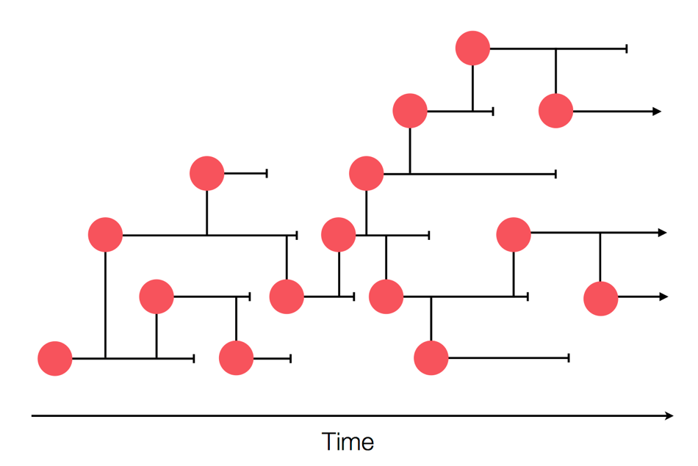
True transmission network
Credit: Trevor Bedford

Slide 10
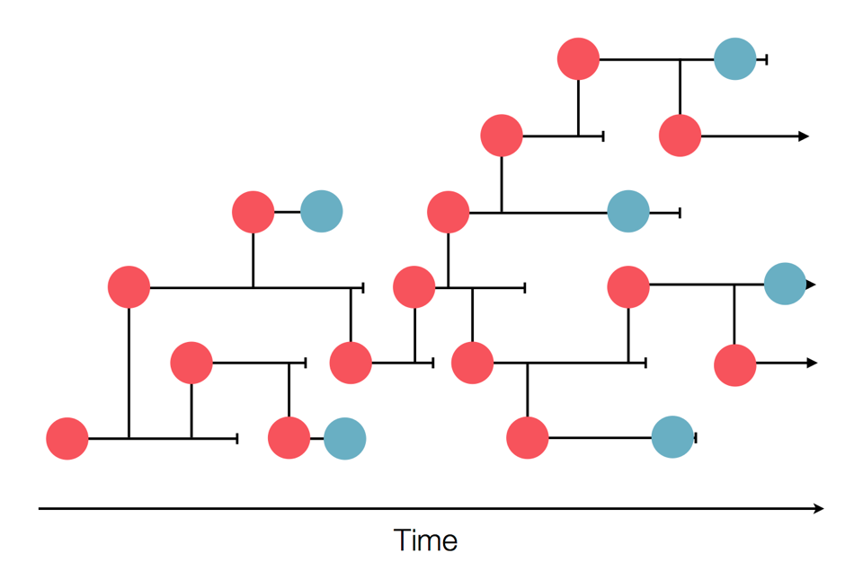
Surveillance network

Slide 11
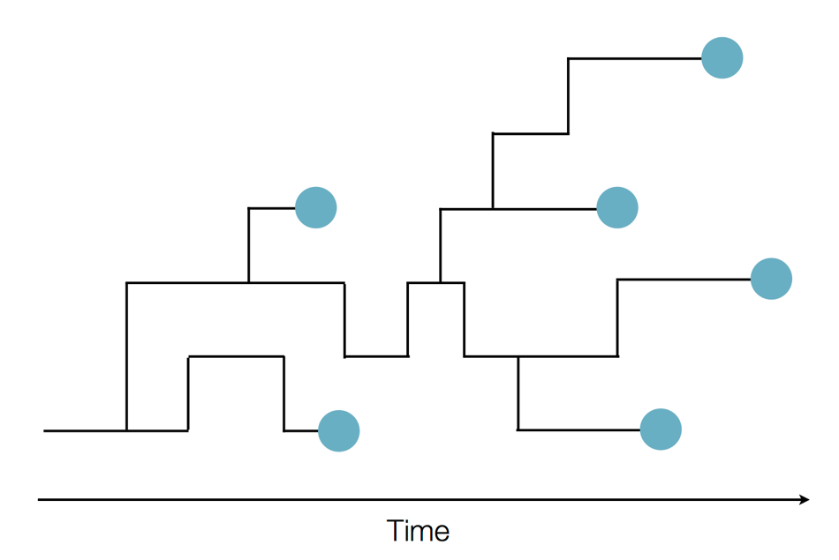
Unknown transmission network

Slide 12
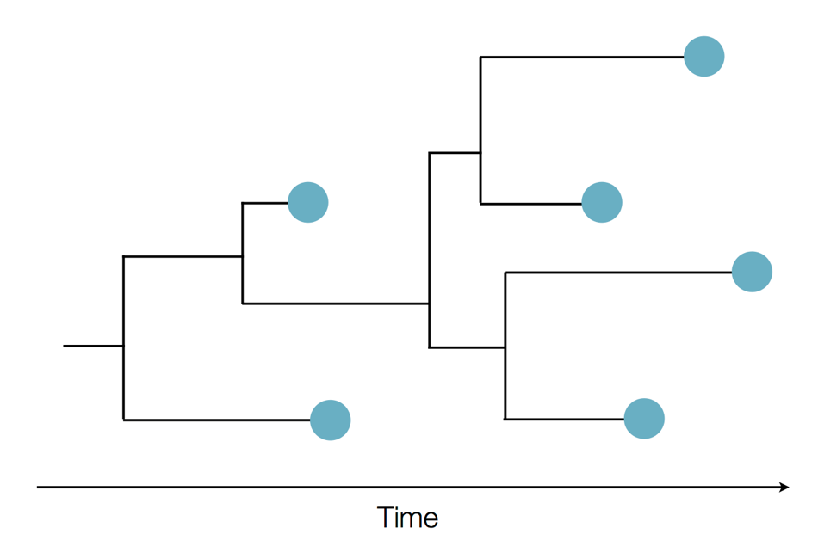
Putting the pieces together

Slide 13
Outbreak reconstruction
Credit: Trevor Bedford

Slide 14
Sequence homology and similarity
Phylogenetic methods are used to determine the evolutionary relationship of organisms based on variations at sequence level (mutations)
Due to mutations, sequences derived from common ancestors (homologs) have distinct levels (%) of similarity
Only homologous sequences can be compared, and their variations can be used to determine how closely/distantly related the organisms are to each other
DENV1 AAAAGTCAGGTCAAACGCAGCTATTGGAGCAGTGTTCGTTGATGAAAATCA
DENV2 AAAGGTGAGAAGCAATGCAGCCTTGGGGGCCATATTCACTGATGAGAACAA
DENV3 AAAGGTCAGAACTAACGCAGCCATGGGCGCCGTTTTCACAGAGGAGAACCA
DENV4 AAAAGTTAGATCAAACGCAGCCATAGGCGCAGTCTTTCAGGAAGAACAGGG
ZIKV CAAGGTGCGCAGCAATGCAGCACTGGGAGCAATATTTGAAGAGGAAAAAGA
WNV AAAAGTCAACAGTAATGCCGCCCTAGGAGCGATGTTTGAAGAACAGAACCA
YFV AAAAGTCCGAAGTCATGCAGCCATTGGAGCTTACCTGGAAGAACAAGAACA
POWV GAAGGTGAGGTCCAACGCTGCTCTAGGTGCATGGTCGGATGAACAGAATAA
*AA*GT********A*GC*GC**T*GG*GC**********GA**A**A***
Multiple sequence alignment (MSA)

Slide 15
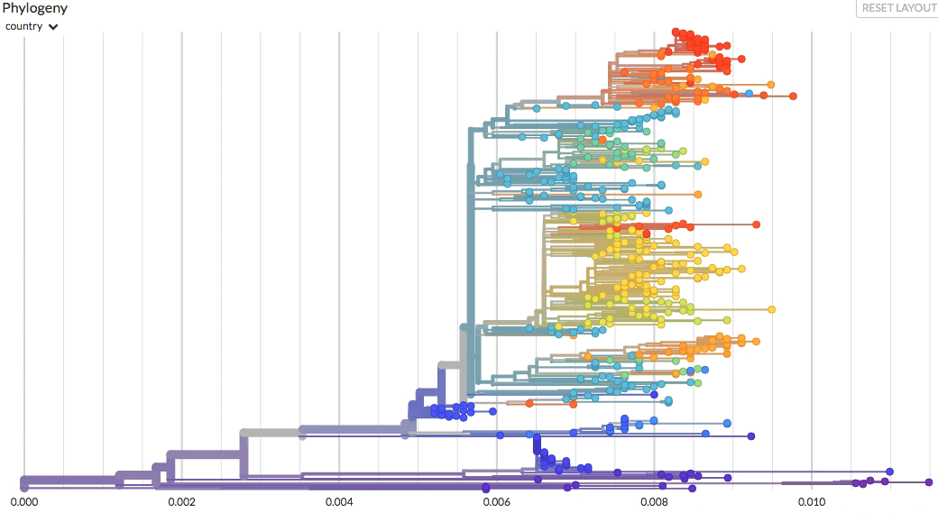
Distinct representations of the same tree

Slide 16
Distinct representations of the same tree

Slide 17
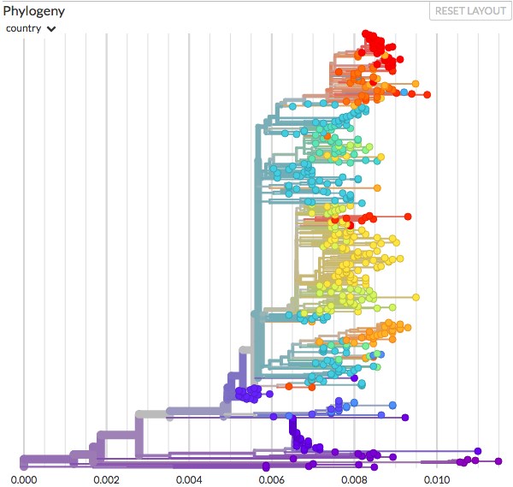
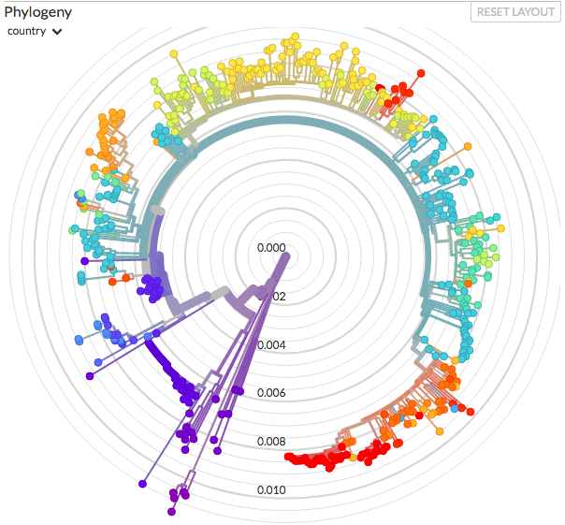
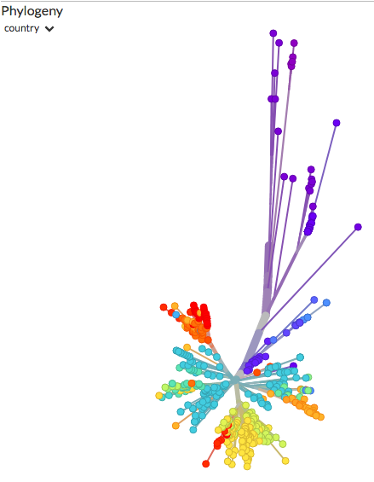
Distinct representations of the same tree
Rectangular and Radial Rooted trees
(most distantly related taxon is known)
Unrooted tree
(direction of evolution unknown)

Slide 18
Reading a phylogenetic tree
Evolutionary relationships can be represented by the bifurcating structure of a tree, which highlight five main components:
Dengue virus 1
Internal node
(ancestral sequences)
Monophyletic clade
(group sharing a common ancestor)
Phylogeny (tree)
Most recent common ancestor (MRCA)
Dengue virus 2
Branch
(time or genetic distance)
Tip/Leaf
(sampled taxon)
Zika virus

Slide 19
Phylogenetic methods

Slide 20
Phylogenetic methods
Parsimony methods
Fits a tree based on discrete-character states (alignment, site +/-, gene order)
Distance methods
Fits a tree to a matrix of pairwise genetic distances
Unweighted Pair Group Method with Arithmetic Mean (UPGMA)
Neighbor-joining (NJ)
Maximum likelihood methods
Searches for the most likely trees that best explain the sequences
PHYML, RAxML
Bayesian methods
Searches for the set of parameters with the highest probabilities that best explain the trees given the sequences
BEAST, Mr. Bayes

Slide 21
Distance methods
Use pairwise distances to infer a tree depicting evolutionary relationships
DENV1
1
Absolute distance
 | DENV1 | DENV3 | POWV
DENV1 | - | 2 | 4
DENV3 | 2 | - | 4
POWV | 4 | 4 | -
1
Alignment
1
DENV3
DENV1 CGTTGATGAAAA
DENV3 CGATGATGAGAA
POWV GGATGAAGAGAA
2
POWV
Dissimilarities
DENV1 CGTTGATGAAAA
DENV3 CGATGATGAGAA
POWV GGCTGAAGATAA
DENV1
0.0833
Relative distance
 | DENV1 | DENV3 | POWV
DENV1 | - | 0.1667 | 0.3333
DENV3 | 0.1667 | - | 0.3333
POWV | 0.3333 | 0.3333 | -
0.0833
0.0833
DENV3
0.1667
POWV

Slide 22
Account for unsampled substitutions
The observed substitutions may reflect how they evolved.
Observed
DENV1
Unsampled event
Unsampled event
Unsampled event
DENV3
Unsampled event
Unsampled event
Unsampled event
POWV
T
?
?
?
A
?
?
?
C
DENV1 CGTTGATGAAAA
DENV3 CGATGATGAGAA
POWV GGCTGAAGATAA

Slide 23
Account for unsampled substitutions
The observed substitutions may reflect how they evolved.
Observed
Actual
DENV1
Unsampled event
Unsampled event
Unsampled event
DENV3
Unsampled event
Unsampled event
Unsampled event
POWV
T
?
?
?
A
?
?
?
C
T
A
C
G
A
G
T
A
C
DENV1 CGTTGATGAAAA
DENV3 CGATGATGAGAA
POWV GGCTGAAGATAA

Slide 24
Substitution models
R_{GA}
R_{AG}
A
Transition
G
To infer more accurate genetic distances, one must select a substitution model that best explains how the sequences evolved.
Such models account for:
Rates of substitution between nucleotides
Rate heterogeneity among sites (1st, 2nd, and 3rd codon positions)
Transition/Transversion ratio
Nucleotide frequency
R_{AT}
R_{CG}
R_{AC}
R_{CA}
Transversions
R_{TG}
R_{GT}
R_{GC}
R_{TA}
C
Transition
T
R_{TC}
R_{CT}
Substitution model
(explains how sequences changed)

Slide 25
Example substitution models
Jukes and Cantor (JC69)
Simplest, assumes frequencies of each nucleotide and rates of change are equal (25%)
HKY85
Considers substitutions as transitions or transversions, same rate
General time reversible (GTR)
Uses a substitution matrix
 | A | C | G | T
A |  | R_{AC} | R_{AG} | R_{AT}
C | R_{CA} |  | R_{CG} | R_{CT}
G | R_{GA} | R_{GC} |  | R_{GT}
T | R_{TA} | R_{TC} | R_{TG}
Substitution matrix

Slide 26
Calculating genetic distances
Substitution models are used to convert measures of sequence dissimilarity into genetic distances, accounting for hidden intermediate mutations (e.g. A → C → G, wrongly interpreted as A → G), and back mutations (e.g. A → C → A, wrongly interpreted as a conserved A).
DENV1 AAAAGTCAGGTCAAACGCAGCTATTGGAGCAGTGTTCGTTGATGAAAATCA
DENV2 AAAGGTGAGAAGCAATGCAGCCTTGGGGGCCATATTCACTGATGAGAACAA
DENV3 AAAGGTCAGAACTAACGCAGCCATGGGCGCCGTTTTCACAGAGGAGAACCA
DENV4 AAAAGTTAGATCAAACGCAGCCATAGGCGCAGTCTTTCAGGAAGAACAGGG
ZIKV CAAGGTGCGCAGCAATGCAGCACTGGGAGCAATATTTGAAGAGGAAAAAGA
WNV AAAAGTCAACAGTAATGCCGCCCTAGGAGCGATGTTTGAAGAACAGAACCA
YFV AAAAGTCCGAAGTCATGCAGCCATTGGAGCTTACCTGGAAGAACAAGAACA
POWV GAAGGTGAGGTCCAACGCTGCTCTAGGTGCATGGTCGGATGAACAGAATAA
Substitution model
DENV1 | 0.000
DENV2 | 0.373 | 0.000
DENV3 | 0.294 | 0.216 | 0.000
DENV4 | 0.294 | 0.431 | 0.333 | 0.000
ZIKV | 0.392 | 0.294 | 0.373 | 0.412 | 0.000
WNV | 0.373 | 0.353 | 0.333 | 0.412 | 0.314 | 0.000
YFV | 0.392 | 0.451 | 0.392 | 0.412 | 0.373 | 0.314 | 0.000
POWV | 0.333 | 0.412 | 0.451 | 0.431 | 0.412 | 0.392 | 0.490 | 0.000
 | DENV1 | DENV2 | DENV3 | DENV4 | ZIKV | WNV | YFV | POWV
A
G
DENV1 | 0.000
DENV2 | 0.358 | 0.000
DENV3 | 0.343 | 0.349 | 0.000
DENV4 | 0.387 | 0.392 | 0.370 | 0.000
ZIKV | 0.656 | 0.583 | 0.668 | 0.612 | 0.000
WNV | 0.564 | 0.562 | 0.557 | 0.544 | 0.562 | 0.000
YFV | 0.456 | 0.474 | 0.495 | 0.481 | 0.616 | 0.570 | 0.000
POWV | 0.523 | 0.502 | 0.519 | 0.560 | 0.599 | 0.574 | 0.454 | 0.000
 | DENV1 | DENV2 | DENV3 | DENV4 | ZIKV | WNV | YFV | POWV
C
T
Correction for multiple mutations
Matrix of dissimilarities (pairwise relative differences)
Distance matrix (expected pairwise genetic distance)

Slide 27
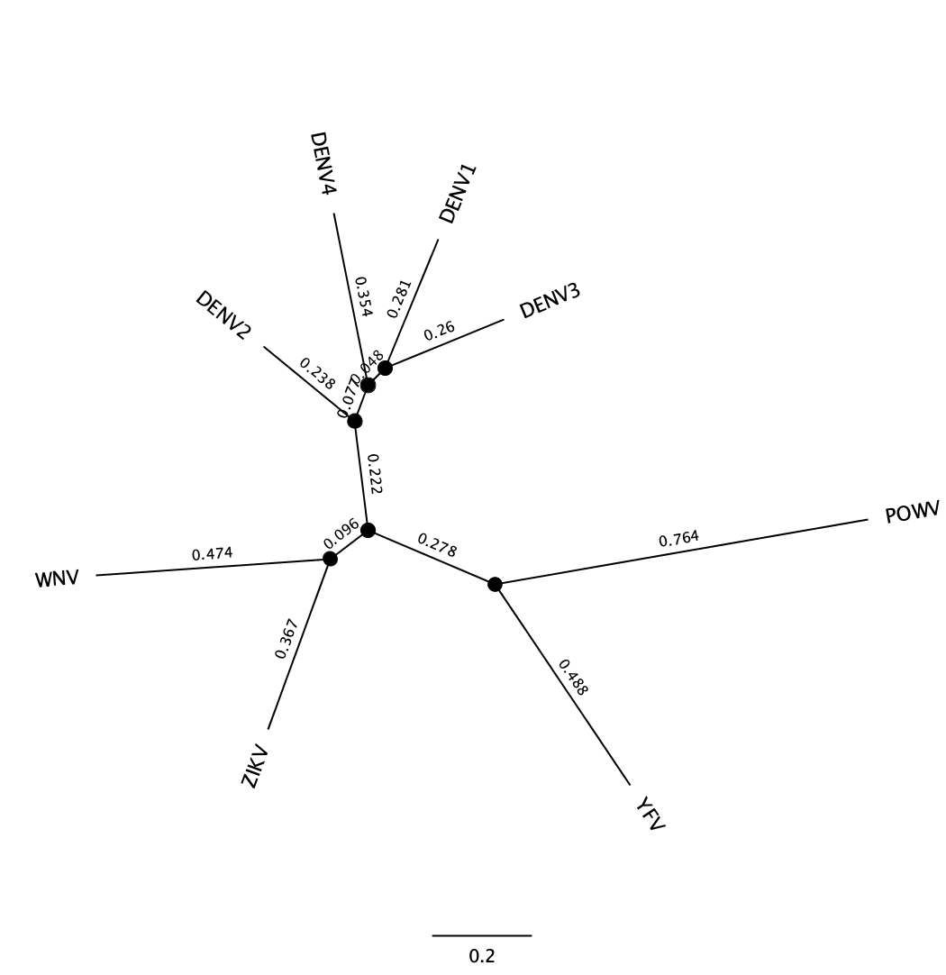
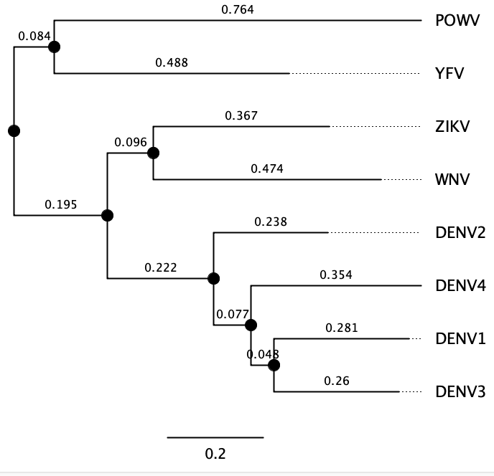
Visualizing distance on a tree
Known
outgroup
Distance[DENV1/DENV3] = 0.281 + 0.26 = 0.541 subs/site
Distance[POWV/YFV] = 0.764 + 0.488 = 1.252 subs/site
Scale = Substitutions/site
Unrooted tree (direction of evolution unknown)
Rooted tree (most distantly related taxon is known)

Slide 28
Maximum likelihood methods
Searches for the most likely trees that explain the sampled data (alignment) given a substitution model
Many trees are proposed to explain the evolution of the sequences, and one of them is the most likely explanation
Explores multiple high likelihood trees (with similar topologies, “shapes”), and provide a relative support value for each internal node (clade)

Slide 29
Maximum likelihood methods
A
C
T
A
C
T
T
C
A
1
2
3
C
C
DENV1 AAA
DENV2 ACA
DENV3 ATA
DENV4 AAA
ZIKV CCA
WNV ATA
YFV ATA
POWV GCA
A
G
C
2
C
T
A
A
A
A
C
A
A
G
T
A
A
A
A
A
A
A
A
A
A
A
C
A
A
C
A
C
T
1
C
A
3
A
A
A
A
Alignment sites
(each column of the MSA)
Substitution model
(explains how sequences changed)
P (ATCG| , )
A
G
Repeat process over tree space, for all sites
(containing trees with different topologies)
C
T
Probability of sequences given the parameters (tree, the substitution model, molecular clock)
The likelihood of a sequence dataset equals the product of the probabilities reconstructed ancestral sites, given the tree and the model

Slide 30
Bayesian methods
Bayesian phylogenetic inference takes advantage of likelihood estimates (like in maximum likelihood approaches), but allow the incorporation of multiple other parameters (priors) in the model
Among such parameters are:
Molecular clock: assumption that sequence changes are accumulate at roughly similar rates
Demographic measures: population dynamics data
Dates: temporal measures of sampling or divergence times
Locations: discrete or continuous (coordinates) values for sampling origin

Slide 31
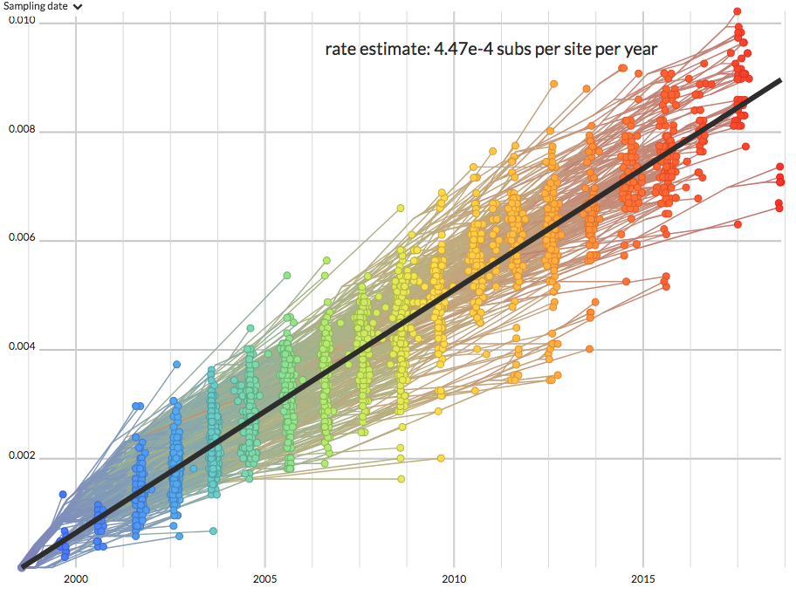
Molecular clock
Root-to-tip analysis
Used to estimate the Evolutionary rate
Not mutation rate
Must be “clock-like”
Genetic divergence
Time

Slide 32
Bayes theorem applied to phylogenetics
Measure similar to the LIKELIHOOD computed in Maximum Likelihood methods
Parameters are known as ‘PRIORS’
Probability of parameters (tree, the substitution model, molecular clock) given the sequences
Probability of sequences given the parameters (tree, the substitution model, molecular clock model)
Probability of the sampled parameters
P ( , , |ATCG) =
P (ATCG| , , ) X
P ( , , )
A
G
A
G
A
G
C
T
C
T
C
T
The POSTERIOR PROBABILITY
P (ATCG)
Probability of the sequences
ATCG
= Sequences
= Sampled tree
A
G
= Substitution model
= Molecular clock model
C
T

Slide 33
Sampling trees using MCMC
Parameter sampling step
(using Markov Chain Monte Carlo, MCMC)
Summarize sampled trees into a single tree
Sequence alignment
+
Substitution model
+
Tree prior
+
Molecular clock prior
+
Other priors (e.g. sampling date, location)
Repeat ‘N’ times until convergence is reached
New sampled parameter set
‘N’ stored trees
Better probability?
New high probability parameters sampled from priors
Store respective (tree) state
If not, reject
If yes, accept

Slide 34
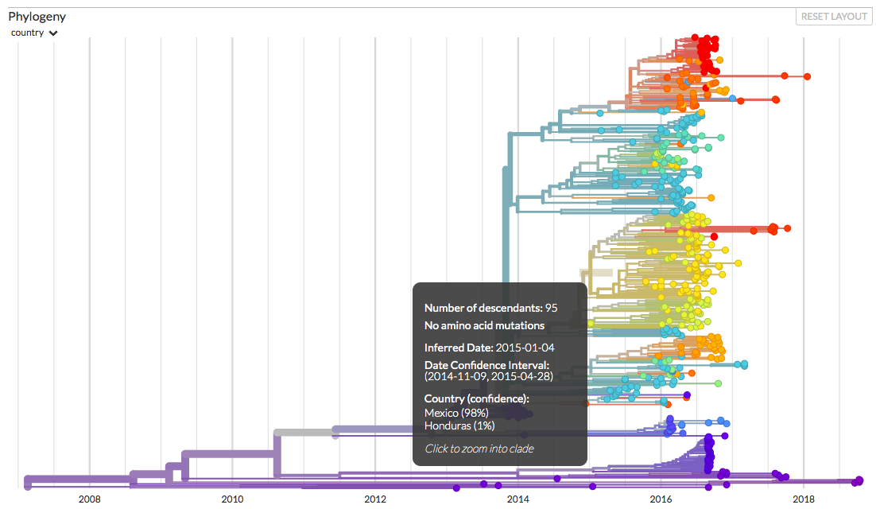
Confidence (posterior probabilities)

Slide 35
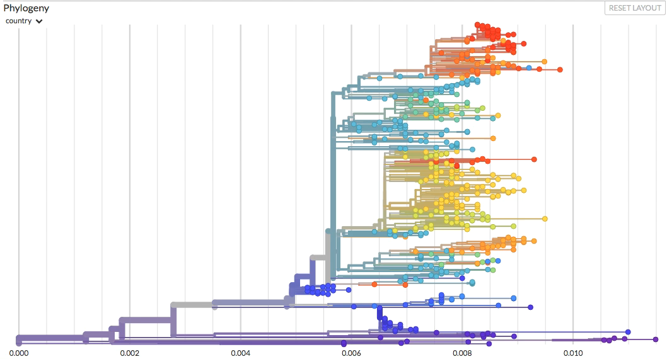
Divergence vs. time-resolved trees

Slide 36
Divergence vs. time-resolved trees

Slide 37
Probability errors and validity

Slide 38
Probability errors
All comparisons of similarity deal with the probability that a particular assignment made by a molecular subtyping method reflects a true epidemiologic relationship of the microorganisms being studied.
This assignment could be wrong!

Slide 39
Types of errors
Type 1 probability error: The chance of erroneously rejecting a null hypothesis that is in fact true.
Molecular epidemiology: chance of erroneously rejecting a subtyping assignment that concludes there is no epidemiologic relationship.
Type 2 probability error: The chance of erroneously failing to reject a null hypothesis that is indeed false.
Molecular epidemiology: chance of failing to reject a subtyping assignment that concludes there is no epidemiologic relationship.

Slide 40
Accounting for probability errors
Similarity (or difference) analysis of patterns and sequences all take into consideration methods that minimize these probability errors.
ML and Bayesian analyses include support and probability.

Slide 41
Evaluating tree support with bootstrapping
Original alignment
Shuffled alignment
(bootstrap replicate 1)
DENV1 AAAAGTCAGGTCAAACGCAGCTATTGGAGCAGTGTTCGTTGATGAAAATCA
DENV2 AAAGGTGAGAAGCAATGCAGCCTTGGGGGCCATATTCACTGATGAGAACAA
DENV3 AAAGGTCAGAACTAACGCAGCCATGGGCGCCGTTTTCACAGAGGAGAACCA
DENV4 AAAAGTTAGATCAAACGCAGCCATAGGCGCAGTCTTTCAGGAAGAACAGGG
ZIKV CAAGGTGCGCAGCAATGCAGCACTGGGAGCAATATTTGAAGAGGAAAAAGA
WNV AAAAGTCAACAGTAATGCCGCCCTAGGAGCGATGTTTGAAGAACAGAACCA
YFV AAAAGTCCGAAGTCATGCAGCCATTGGAGCTTACCTGGAAGAACAAGAACA
POWV GAAGGTGAGGTCCAACGCTGCTCTAGGTGCATGGTCGGATGAACAGAATAA
DENV1 GCAGCTATTGGATGAAAATCAAGAGCAGTTTAAAGTCAGGTCAAACATCAA
DENV2 GCAGCCTTGGGATGAGAACAAAGGGCCATCTAAGGTGAGAAGCAATACAAA
DENV3 GCAGCCATGGGAGGAGAACCAAGCGCCGTCAAAGGTCAGAACTAACACCAA
DENV4 GCAGCCATAGGAAGAACAGGGAGCGCAGTAGAAAGTTAGATCAAACAGGGA
ZIKV GCAGCACTGGGAGGAAAAAGACGAGCAATAAAAGGTGCGCAGCAATAAGAC
WNV GCCGCCCTAGGAACAGAACCAAGAGCGATAAAAAGTCAACAGTAATACCAA
YFV GCAGCCATTGGAACAAGAACAAGAGCTTAAAAAAGTCCGAAGTCATAACAA
POWV GCTGCTCTAGGAACAGAATAAGGTGCATGATAAGGTGAGGTCCAACATAAG
Shuffled alignment
(bootstrap replicate 2)
Shuffled alignment
(bootstrap replicate N)
DENV1 GTTGACAGGTCAAACATTGCAGTGTTCGTTGATGAAAATCAGCAGCTCGCG
DENV2 ACTGAGAGAAGCAATTTGGCCATATTCACTGATGAGAACAAGCAGCCCACA
DENV3 ACAGACAGAACTAACATGGCCGTTTTCACAGAGGAGAACCAGCAGCCCACA
DENV4 CAGGATAGATCAAACATAGCAGTCTTTCAGGAAGAACAGGGGCAGCCTCTC
ZIKV GAAGAGCGCAGCAATCTGGCAATATTTGAAGAGGAAAAAGAGCAGCATGTG
WNV GAAGACAACAGTAATCTAGCGATGTTTGAAGAACAGAACCAGCCGCCTGTG
YFV GAAGACCGAAGTCATATTGCTTACCTGGAAGAACAAGAACAGCAGCCGGGG
POWV GATGAGAGGTCCAACCTAGCATGGTCGGATGAACAGAATAAGCTGCTGGGG
DENV1 TAAGGTCAAACGCATGAAATTGAAGCAGAGCAGTGTTCGTTGAATCAGTCA
DENV2 TAAGAAGCAATGCATGAGTTGGAGGGAGGGCCATATTCACTGAACAAGTGA
DENV3 TAAGAACTAACGCAGGAGATGGAGGCAGCGCCGTTTTCACAGAACCAGTCA
DENV4 TAAGATCAAACGCAAGAAATAGAAGTAGCGCAGTCTTTCAGGAAGGGGTTA
ZIKV TCAGCAGCAATGCAGGAACTGGAGGGCGAGCAATATTTGAAGAAAGAGTGC
WNV TAAACAGTAATGCCACAGCTAGAAGCAGAGCGATGTTTGAAGAACCAGTCA
YFV TAAGAAGTCATGCAACAAATTGAAGCCGAGCTTACCTGGAAGAAACAGTCC
POWV TGAGGTCCAACGCTACAGCTAGAGGGAGTGCATGGTCGGATGAATAAGTGA
Bootstrap replicate alignments are generated and used for tree inference

Slide 42
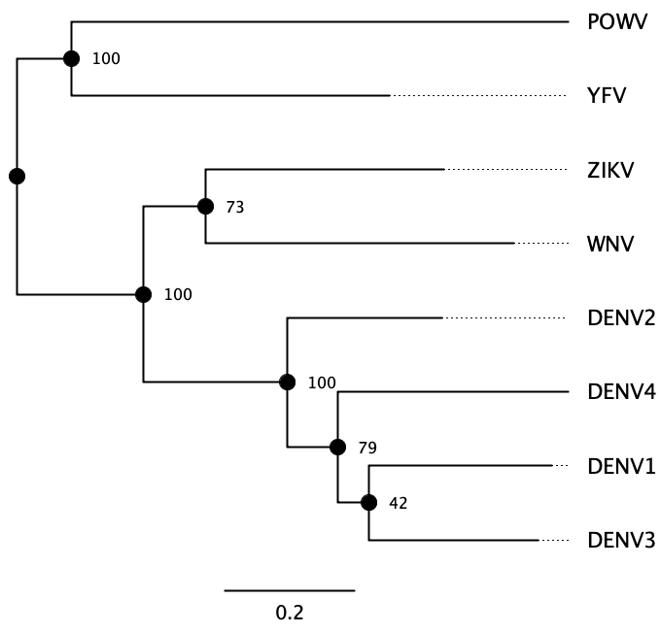
Evaluating tree support with bootstrap
Bootstrap tests the relative stability of clades after resampling, reporting how frequent such clades are over several tree reconstructions using shuffled alignments

Slide 43
Errors can still occur
They arise through various mechanisms
Undersampling
Limited “genetic signal“
Contamination
Sequencing errors
Misclasification

Slide 44
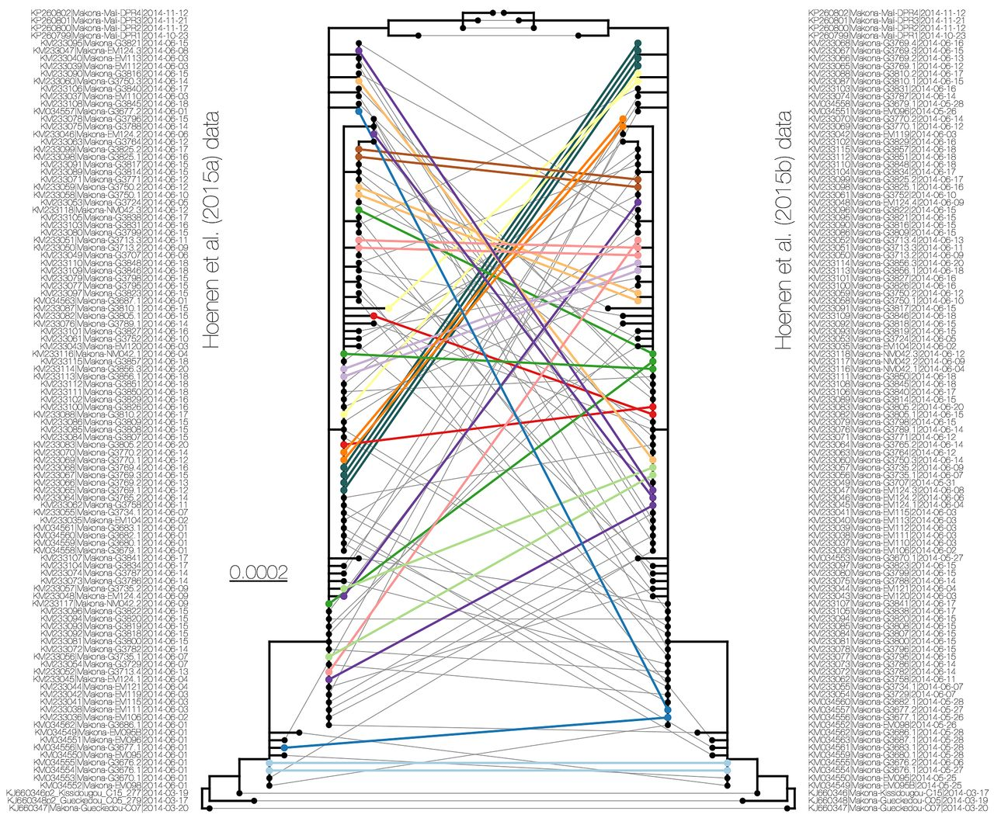
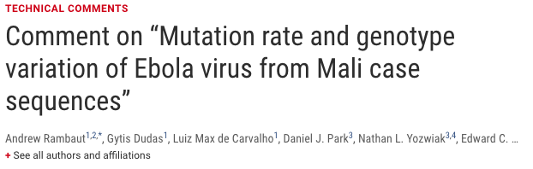
Misclassification

Slide 45
Validation of results
Cannot test hypothesis with low support or probability values
Use multiple tests (Distance, ML, and Bayesian trees)
Determine validity empirically, when possible
Confirm via alternate tests (e.g. PCR)
Inferring genotype-phenotype relationships, measure phenotype
New methodology - compare to “gold standard”
Validate with epidemiological data
well-recognized outbreaks and well-conducted disease surveillance systems

